Slide 1
Data Models (Module-II)
Dr.Hemalatha K
Assistant professor SCOPE,VIT Chennai.

Slide 2
What is IoT Data management
It enables users to track, monitor and manage the devices to ensure the devices to work properly and securely after deployment.

Slide 3
Why Data Management is need?
IoT sensors interact with people, homes, cities, farms, factories, workplaces, vehicles, wearables and medical devices, and beyond.
it is changing our lives from managing home appliances to vehicles. The technology of devices can now advise us about what to do, when to do and where to go.
Industrial IoT applications assist us in managing the data for processes, and predicting faults and disasters.
  The IoT platforms help set and maintain parameters to refine
and store data accordingly.

Slide 4
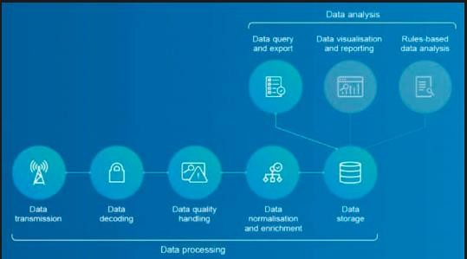
Data Management Process
The process of taking the overall available data and refining it down to important information.
  Different devices from different applications send large volumes and varieties of information. Managing all this IoT data means is developing and executing architectures, policies, practices and procedures that can meet the full data lifecycle needs.
Things are controlled by smart devices to automate tasks, so we can save our time.
Intelligent things can collect, transmit and understand information, but a tool will be required to aggregate data and draw out inferences, trends and patterns.

Slide 5
IoT data management techniques
cloud computing
data processing happens in a centralised data storage location
Sensors and devices can connect indirectly through the cloud, where data is centrally- managed, or send data directly to other devices to locally collect, store and analyse the data, and then share selected findings or information with the cloud
Edge computing
data is processed near the data source or at the edge of the network. By processing and using some data locally, the IoT saves storage space for data, processes information faster and meets security challenges.
Sensors produce a large amount of data for edge gateway devices so that these can make decisions by analysing the data
Edge devices for data
management help secure the most valuable data and reduce bandwidth cost.

Slide 6
Data Management challenges
Space Optimization : the number of IoT devices will increase, thus increasing the challenges for real-time processing and analysis to reduce time for storage.
Identification of tools: Functions such as adaptive maintenance, predictive repair, security monitoring and process optimization rely on real-time data selecting the right tools is a challenge because integration between different sensors should be proven and compatibilities confirmed.
When there is no connection, devices must still gain insights, make decisions and prepare for data distribution.

Slide 7
Tagging of Data

Slide 8
Data forms
Text data on paper
Bytes as electronic memory storage.
Twitter data
image data
structured data
semi structured data
unstructured data
views
likes
tagged data, meta data

Slide 9
Example-I
Google Data power
  Through an email can seen a pop-up ad, that you saw from the browser before.
  How it is happening?
    Google software read your email, saw that you mentioned unicorn hoodies, found an advertisement for one, and then offered them to you.
    Google collects billions of data points every single second from users around the world.
    Data points come from Gmail, Google searches, G Suite, Google Chrome, YouTube,

Slide 10
Example -II
Real estate website that provides home values for free.
They started making agreements with local real estate associations to port their local sales information directly to Zillow’s database.
Zillow gets data from realtors. It uses that data to attract homebuyers online, generating leads for realtors, and then sells this data back to the realtors, who gave them the data in the first place.

Slide 11
Data organization
Data is more powerful when it is organized properly
– It’s the ability, as a business owner, to see and understands the trends in your customers’ behavior and make proactive, rather than
reactive changes in order to increase your bottom line sales

Slide 12
Advantages of Data collectors
Monetization of data for gaining the money.
– Social media networks such as Facebook, Twitter, and LinkedIn use data to make money.
Collecting data on your customers and their trends

Slide 13

Tags
Organizing the data
  Collecting data
  Learn how to track
  Using the data
Tags are something you can assign to any set of data. A set of data can be
tagged with one, or multiple tags.
  social media post with hashtags.
Process of Tagging
  is a kind of indexing, a process of labelling and categorizing information made to support resource discovery for users.
    Social tagging generally means the practice whereby internet users generate keywords to
describe, categorize or comment on digital content
Tags are a very efficient way to organize data sets, such as customers,
  improve the experience businesses with categoric data
Some data with multiple tags.
  Customer might be with more than one tag.
CRMs have multiple data fields that you can input for each customer. Any field where you can add a category that is common across the different customers, and if you can categorize them with more than one of those category options, using tags.

Slide 14

HashTag
Assigning the set of data of social media data with hashtags.
A hashtag is a metadata tag that is prefaced by the hash symbol, #. Hashtags are widely used on microblogging and photo-sharing services such as Twitter and Instagram as a form of user- generated tagging that enables cross-referencing of content sharing a subject or theme.
hashtag is used to draw attention, organize, promote, and connect. It is started on Twitter as a way of making it easier for people to find, follow, and contribute to a conversation
Instagram every post is tagged with a specific hashtag.
  a hashtag called #chicagofood that is attached to about 791,000 posts.
  #ginoseastpizza (a restaurant in Chicago) which is attached to just over 1000 posts

Slide 15
Why use hashtags?
Hashtags helps to get found of target audience.
Hashtags improve your click through rates (CTR)
Hashtags are great for research
Hashtags bring like-minded people together.
Hashtags can be used for humor

Slide 16
Contd.,
#business, #entrepreneur or #marketing
Specifying
  put the pound sign directly in front of the word or phrase you want to turn into a hashtag and follow these simple rules:
  No spaces
  No punctuation
  No special characters
  capitalization for readability(optional)

Slide 17
WITHOUT THE TAGS, SENDING EVERYONE IN YOUR DATABASE EVERYTHING YOU HAVE TO OFFER, WHICH IS NOT AS EFFECTIVE.

Slide 18
Types of Tags
One Tag
Multiple Tags
Hyper-targeted advertising tags

Slide 19
One Tag
Only one tag is associated with the data of the customer data
  Buying only beauty products by the customer
  Buying only sports goods from the same company

Slide 20
Multiple tags
Assigning more than one tag to a customer by the company
  the customer who buys beauty products and sporting goods
  With tags, a company can assign as many different tags to a customer as they need and desire.
  Now it’s up to the company’s marketing team to market to customers based on how they are tagged;

Slide 21
Targeted advertising
Targeted advertising is a form of advertising, an online advertising, that is directed towards an audience with certain traits(quality parameters), based on the product or person the advertiser is promoting.
These traits can either be demographic with a focus on race, economic status, gender, age, generation, level of education, income level, and employment, or there can be a psychographic focus which is based on the consumer values, personality, attitude, opinion, lifestyle and interest.

Slide 22
Importance of target advertising
Digital data radically increase, and it spreads across numerous ICT channels cohesively.
The emergence of new online channels, the need for targeted advertising is increasing
Companies aim to minimize wasted advertising by means of information technology.

Slide 23
Issues with targeted advertising
the lack of 'new' advertisements of goods or services.
  Seeing as all ads are tailored to be based on user preferences, no different products will be introduced to the consumer.
– In this case the consumer will be at a loss as they are not exposed to anything new.

Slide 24
Hyper-targeted advertising
Hyper-targeting is a marketing strategy where you clearly identify a target customer and deliver extremely relevant messages in the places where they will be most likely to see it.
Definitions in Hyper-targeted advertising
  Buyer persona
    More details about customer profile outlines who your target customer is by defining their demographics, sociographic, professional roles, values, goals, challenges, influences and buying habits
  Segmentation
    Dividing the audience into smaller groups based on their interactions with your brand or their demographics, sociographic, professional roles, values, goals, challenges, influences and buying habits.
  Geo-targeting
    The act of targeting a customer based on their location. This could be as broad as targeting by country or as narrow as targeting by zip-code or mile-radius around a location or business.
  Retargeting
    The act of sending messages to audiences who have already engaged with your brand. This could include remarketing to people who have visited your website, visited your store, made a purchase, followed your brand on social, signed up for an online based offer, or had any other interaction with your brand.

Slide 25
Benefits
Deliver personalized marketing messages that are relevant to what customers actually what and need, and stop sending customers marketing messages about products and services they have no interest in.
Get a better value for your ad spend because you can reach the right audiences and not spend money on ad campaigns that are reaching the wrong audiences.
Get the qualified leads from people who are likely to become customers, and avoid filling your funnel or pipeline with uninterested audiences.
Generate more sales by marketing the right offerings to the right customers on the right platforms.
When executed properly, hypertargeting can make it easier for you to connect with customers, generate leads, and increase your sales.

Slide 26
Scenario
Consider a situation where shop keeper wants to know which products are needs more to buy for his next seasons.
  Who is his regular customers
  Which items are seasonal based.
  Ordering the stock based on predictions.
Detail about the data collection process for the above problem and how the data will be organized from it and details any technique that will structure the data.

Slide 27
Tag data to pre-process large datasets

Slide 28
Steps to Tag Data for Pre- Processing Large Datasets

Slide 29
Understand the Dataset:
  Analyze the dataset to identify important features, patterns, or categories that need tagging.
  Example: In a dataset of customer reviews, tags could include "Positive Sentiment," "Negative Sentiment," or "Neutral Sentiment."

Slide 30
Define Tagging Criteria:
  Determine the rules for creating and applying tags.
  Tags could be based on:
    Categories: "High Priority," "Low Priority."
    Context: "E-commerce," "Healthcare."
    Data Type: "Numeric," "Categorical," "Text."

Slide 31
Select or Create Tags:
  Use predefined tags or create new ones based on domain-specific requirements.
  Example: For a product catalog, tags might include "Electronics," "Clothing," "Under $50."

Slide 32
Automate Tagging:
  Use tools or scripts to automate the tagging process for large datasets.
  Methods include:
    Keyword Matching: Applying tags based on specific words or phrases.
    Regular Expressions: For pattern-based tagging (e.g., detecting email addresses or phone numbers).
    Machine Learning Models: Use classification models to predict and assign tags (e.g., spam detection).

Slide 33
Validate Tags:
  Check the accuracy of the tags to ensure they align with the dataset's intended use.
  Example: Verify that all "Spam" emails are correctly tagged in an email dataset.
Store Tags Efficiently:
  Include tags as additional columns in structured datasets (e.g., CSV, SQL tables).
  Use metadata fields in unstructured data formats (e.g., JSON, XML).

Slide 34
Use Tags in Pre-Processing:
  Filter Data: Extract subsets of data based on tags (e.g., "High Priority" rows).
  Normalize Data: Use tags to identify columns requiring normalization or standardization.
  Handle Missing Values: Tags like "Missing" or "Null" can help locate and impute missing data.

Slide 35
Examples of Tagging Data for Pre-Processing
Text Data:
Tag: "Sentiment" → Values: "Positive,"
"Negative," "Neutral."
Tag: "Topic" → Values: "Sports," "Politics,"
"Technology."
Image Data:
Tag: "Object Detected" → Values: "Cat," "Dog,"
"Car."
Tag: "Resolution" → Values: "Low," "Medium,"
"High."

Slide 36
Advantages of Tagging for Pre-Processing
Efficient Filtering:
  Tags make it easy to subset and analyze specific portions of
the dataset.
Improved Data Quality:
  Helps identify outliers, missing values, or errors for correction.
Faster Processing:
  Pre-tagged data reduces the time needed for downstream
processing.
Enhanced Machine Learning Pipelines:
  Tagged data simplifies feature selection and improves model
accuracy.

Slide 37
Challenges
Scalability:
  Automating tagging for extremely large datasets can be computationally expensive.
Consistency:
  Ensuring uniform application of tags across the dataset is critical.
Tag Clutter:
– Too many tags or irrelevant tags can complicate the data structure.

Slide 38
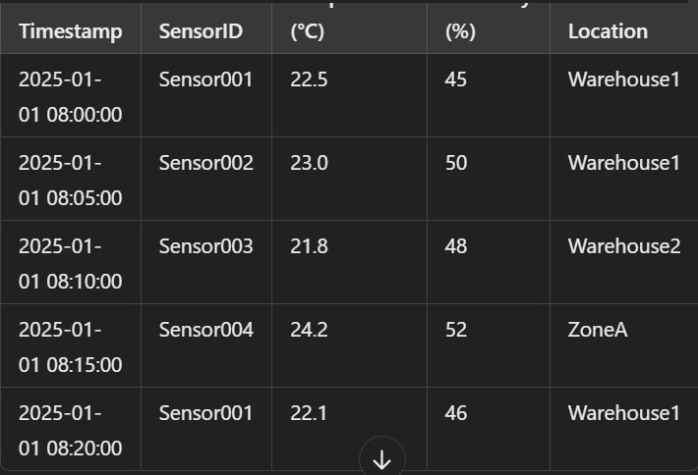
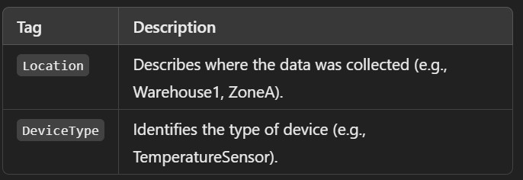
Example
Sample IoT Sensor Dataset
Define Tagging Rules

Slide 39
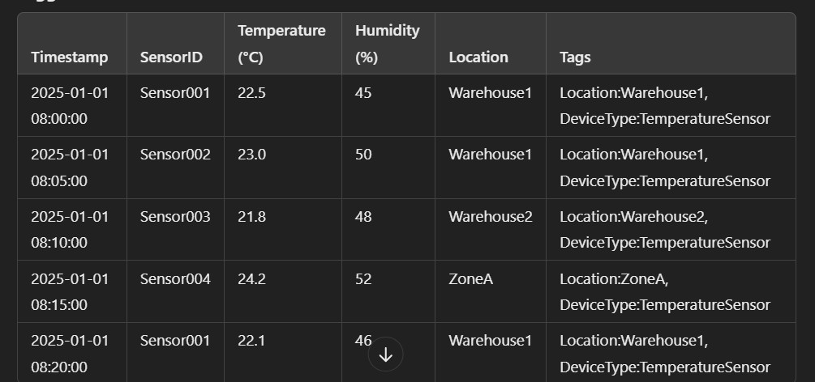
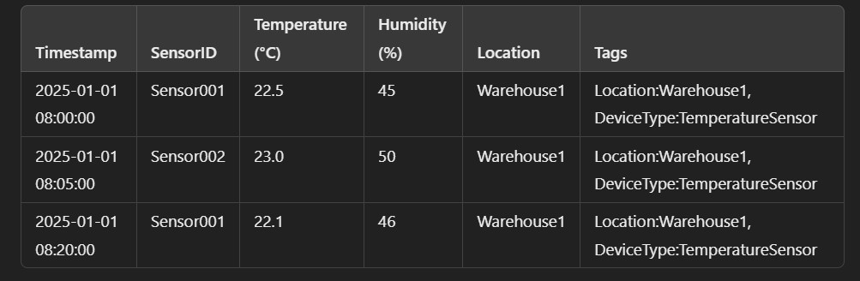
contd..,
Tagged data
Filtered Data (for Location:Warehouse1):

Slide 40
Contd.,
Generate CSV for Tagged data
Analyze the Tagged Data
  Count the number of records for each location
  Calculate the average temperature for each location

Slide 41
Data usage

Slide 42
Forecasting
Ancestors observed the sky to forecast the weather
Data Scientists develop and train machine learning models to predict sales, risks, events, trends, etc
  Based on data decisions need to be made about what should be forecast

Slide 43
Forecasting types
Based on data availability
  Qualitative Forecasts :If there are no data available, or if the
data available are not relevant to the forecasts.
    Qualitative forecasting involves using expert opinions, market research, and judgment rather than historical data to make predictions. These methods are typically used when data is limited or unavailable and rely on human intuition and experience to make future projections.
    Qualitative forecasts are particularly useful for new products, technological innovations, or in situations where rapid changes make historical data unreliable
  Quantitative Forecasts (Time Series Forecasting): If numerical information about the past is available; and the past patterns will continue into the future

Slide 44
Forecasting types
Based on time horizon
  Short term forecasts : a normal range between one and three
months
    Use cases : Traffic prediction, stock price prediction, energy demand forecasting, sales forecasting.
  Medium term forecasts : the time period is normally one year
    Usecases : Retail,Manufacturing,Energy,Healthcare and Finance.
  Long term forecasts: predict results over periods greater than two years
    Usecases : Retail,Manufacturing,Energy,Healthcare and Finance Techniques: Time series Models (ARIMA,SARIMA,Holt- Winters);Machine Learning Models (Random
Forest,XGBoost,LSTM),Exponential Smoothing,Trend Prediction
and Regression models etc.,

Slide 45
Forecasting Methods
Judgmental Forecasting is the only option for Qualitative Forecasts due to the lack of historical data ; Examples of a new policy, a new product, or a new competitor
Time Series Forecasting methods only use historical values on the variable to be forecast and exclude the factors that could affect its behavior such as competitor activities, changes in environment or economic conditions, and so on

Slide 46
Predictive Modelling
the process of using known results to create, process, and validate a model that can be used to forecast future outcomes or predictions.
a tool used in predictive analytics, a data mining technique that attempts to answer the question "what might possibly happen in the future?“.
Mostly used predictive modeling techniques are
:regression and neural networks
– For example, predictive modeling could help identify customers who are likely to purchase new product over the next 90 days.
Companies can use predictive modeling to forecast events, customer behavior, as well as financial, economic, and market risks.

Slide 47
Predictive modeling is a process that uses data and statistics to predict outcomes with data models.
  These models can be used to predict anything from sports outcomes and TV ratings to technological advances and corporate earnings.
Predictive modeling is also often referred to as:
  Predictive analytics
  Predictive analysis
  Machine learning

Slide 48
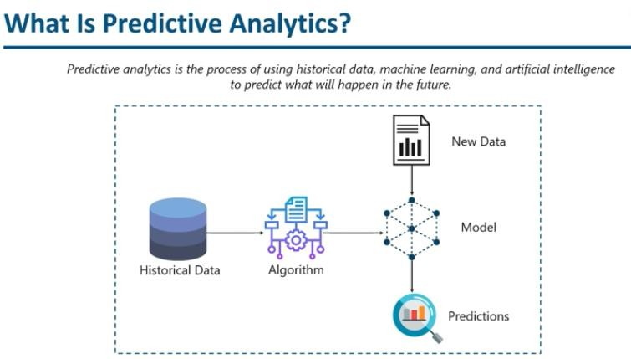

Slide 49
Why predictive modelling
analysing historical events.
increase the probability of forecasting events, customer behavior, as well as financial, economic, and market risks

Slide 50
How the data is retrieved?
rapid migration to digital products has created a sea of data that is readily available to businesses.
Big data is utilized by companies to improve the dynamics of the customer-to-business relationship.
This vast amount of real-time data is retrieved from sources such as social media, internet browsing history, cell phone data, and cloud computing platforms.

Slide 51
Examples
The bank wants to identify which of its customers are likely to engage in money laundering(clearing) activities.
The bank’s customer data, a predictive model is
built around the dollar amount of money transfers that customers made during a period of time.
The model is taught to recognize the difference between a money laundering transaction and a normal transaction. The optimal outcome from the model should be a pattern that signals which customer laundered money and which didn’t. If the model perceives that a pattern of fraud is emerging for a particular customer, it will create a signal
for action, which will be attended to by the bank’s fraud
prevention unit.

Slide 52
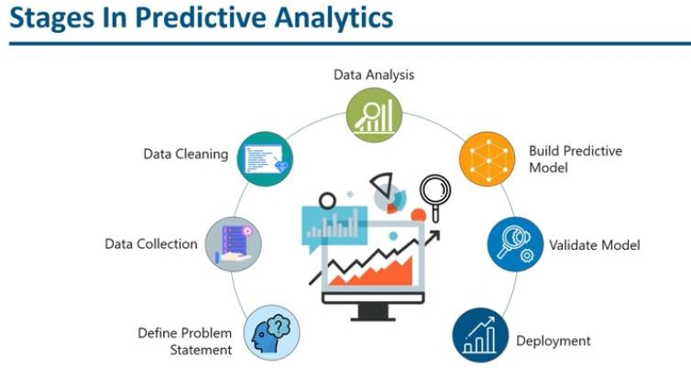

Slide 53
Process of Predictive Analysis
Predictive analysis consists of 7 processes as follows:
Define project: Defining the project, scope, objectives and result.
Data collection: Data is collected through data mining providing a complete view of customer interactions.
Data Cleaning: It is the process of cleaning, inspecting,
Data Analysis: . transforming and modelling the data
– Statistics: This process enables validating the assumptions and testing
the statistical models.
Predictive Modelling: Predictive models are generated using statistics and the most optimized model is used for the deployment.
Deployment: The predictive model is deployed to automate the production of everyday decision-making results.
Validating the data: Keep monitoring the model to review
performance which ensures expected results.
https://www.geeksforgeeks.or g

Slide 54
Predictive Modelling Tools
Tools are ability to handle linear and non-linear data relationships.
  Neural networks
  decision trees,
  time series data mining, and
  Bayesian analysis
  big data
    Ordinary Least Squares
    Generalized Linear Models (GLM)
    Logistic Regression
    Random Forests
    Decision Trees
    Neural Networks
    Multivariate Adaptive Regression Splines (MARS)

Slide 55
What are the Biggest Challenges of Predictive Modeling?
predictive modeling presents a number of challenges in practice.
These challenges include:
  Sufficiently large and comprehensive datasets
  Adaptability of models to new problems
  Data organization and hygiene
  Data privacy and security

Slide 56
Need of Predictive Analysis
Understanding customer behavior: Predictive analysis uses data mining feature which extracts attributes and behavior of customers. It also finds out the interests of the customers so that business can learn to represent those products which can increase the probability or likelihood of buying.
Gain competition in the market: With predictive analysis, businesses or companies can make their way to grow fast and stand out as a competition to other businesses by finding out their weakness and strengths.
Learn new opportunities to increase revenue: Companies can create new offers or discounts based on the pattern of the customers providing an increase in revenue.
Find areas of weakening: Using these methods, companies can gain back their lost customers by finding out the past
actions taken by the company which customers didn’t like.
https://www.geeksforgeeks.or g

Slide 57
Applications of Predictive Analysis
Health care: Predictive analysis can be used to determine the
history of patient and thus, determining the risks.
Financial modelling: Financial modelling is another aspect where predictive analysis plays a major role in finding out the trending stocks helping the business in decision making process.
Customer Relationship Management: Predictive analysis helps firms in creating marketing campaigns and customer services based on the analysis produced by the predictive algorithms.
Risk Analysis: While forecasting the campaigns, predictive analysis can show an estimation of profit and helps in evaluating the risks too.
https://www.geeksforgeeks.or g

Slide 58
References
https://www.godaddy.com/garage/what-is- hypertargeting/
https://textsanity.com/text-message-marketing/why- tags-are-the-best-way-to-organize-your-data/
https://www.investopedia.com/terms/p/predictive- modeling.asp
https://medium.com/@osiolabs/what-is-an-etl- extract-transform-load-pipeline-in-node-js- 9a1a17de30f1
https://towardsdatascience.com/forecasting- fundamentals-you-should-know-before-building- predictive-models-299a18c2093b

Slide 59
References
https://www.godaddy.com/garage/what-is- hypertargeting/
https://textsanity.com/text-message-marketing/why- tags-are-the-best-way-to-organize-your-data/
https://www.investopedia.com/terms/p/predictive- modeling.asp
https://medium.com/@osiolabs/what-is-an-etl- extract-transform-load-pipeline-in-node-js- 9a1a17de30f1
https://towardsdatascience.com/forecasting- fundamentals-you-should-know-before-building- predictive-models-299a18c2093b

